Slide 1
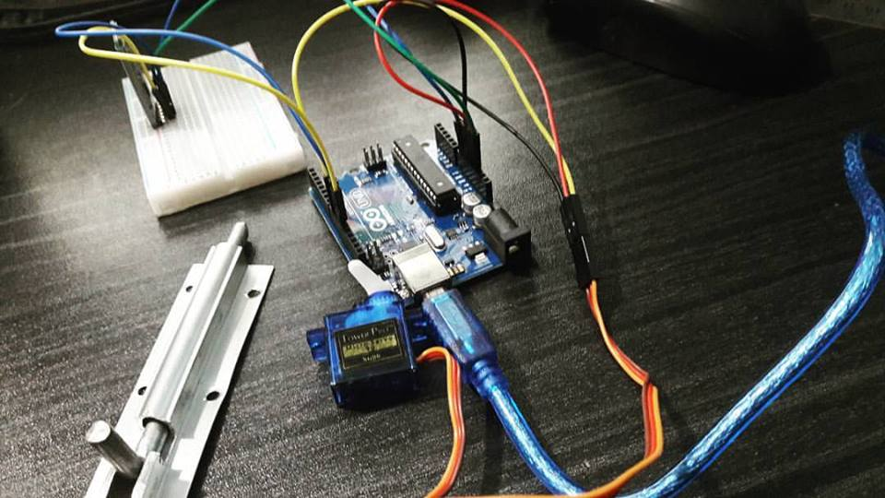
ANDROID
CONTROLLED
DOOR LOCK

Slide 2

PRESENTED BY:
1.Anika Tabassum(011161150)
2.Syeda Fabliha Rahman(011161152)
3.Mahfujur Rahman(011161156)
4.Progya Paromita Urmee(011161157)
5.Nazia Parvin Urmi(011161201)
6.Syed Adib Arman(011161251
Section : E
Group NO : 03.

Slide 3
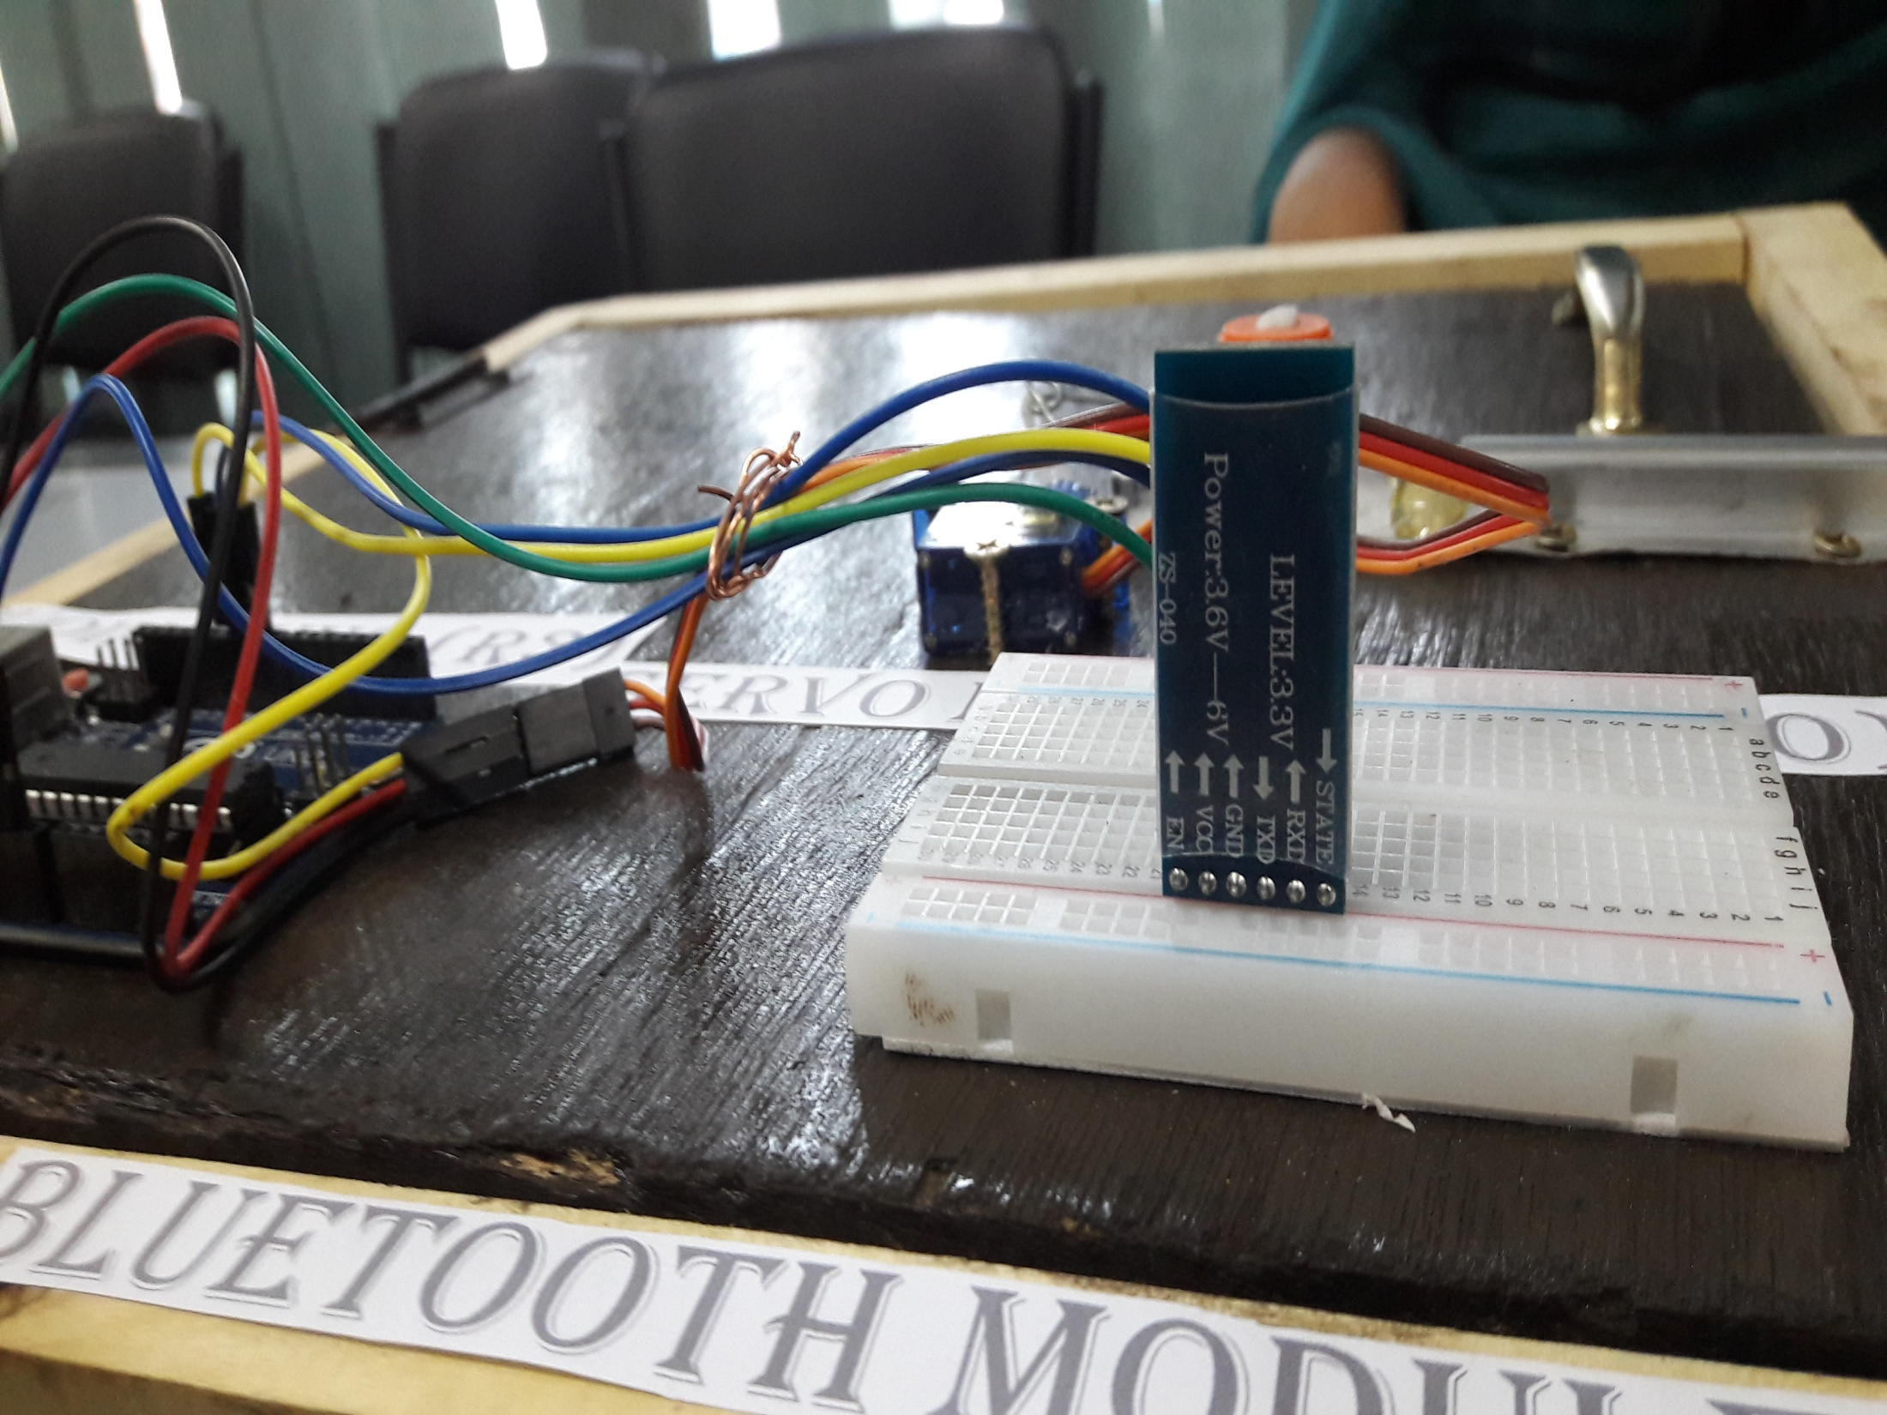
OUTLINE…
WHAT IS ANDROID CONTROLLED DOOR LOCK
COMPONENTS
HOW DOES IT WORK
USEFULNESS
PROJECT COST
MARKET VALUE
LACKINGS
FUTURE IMPLEMENTATION

Slide 4
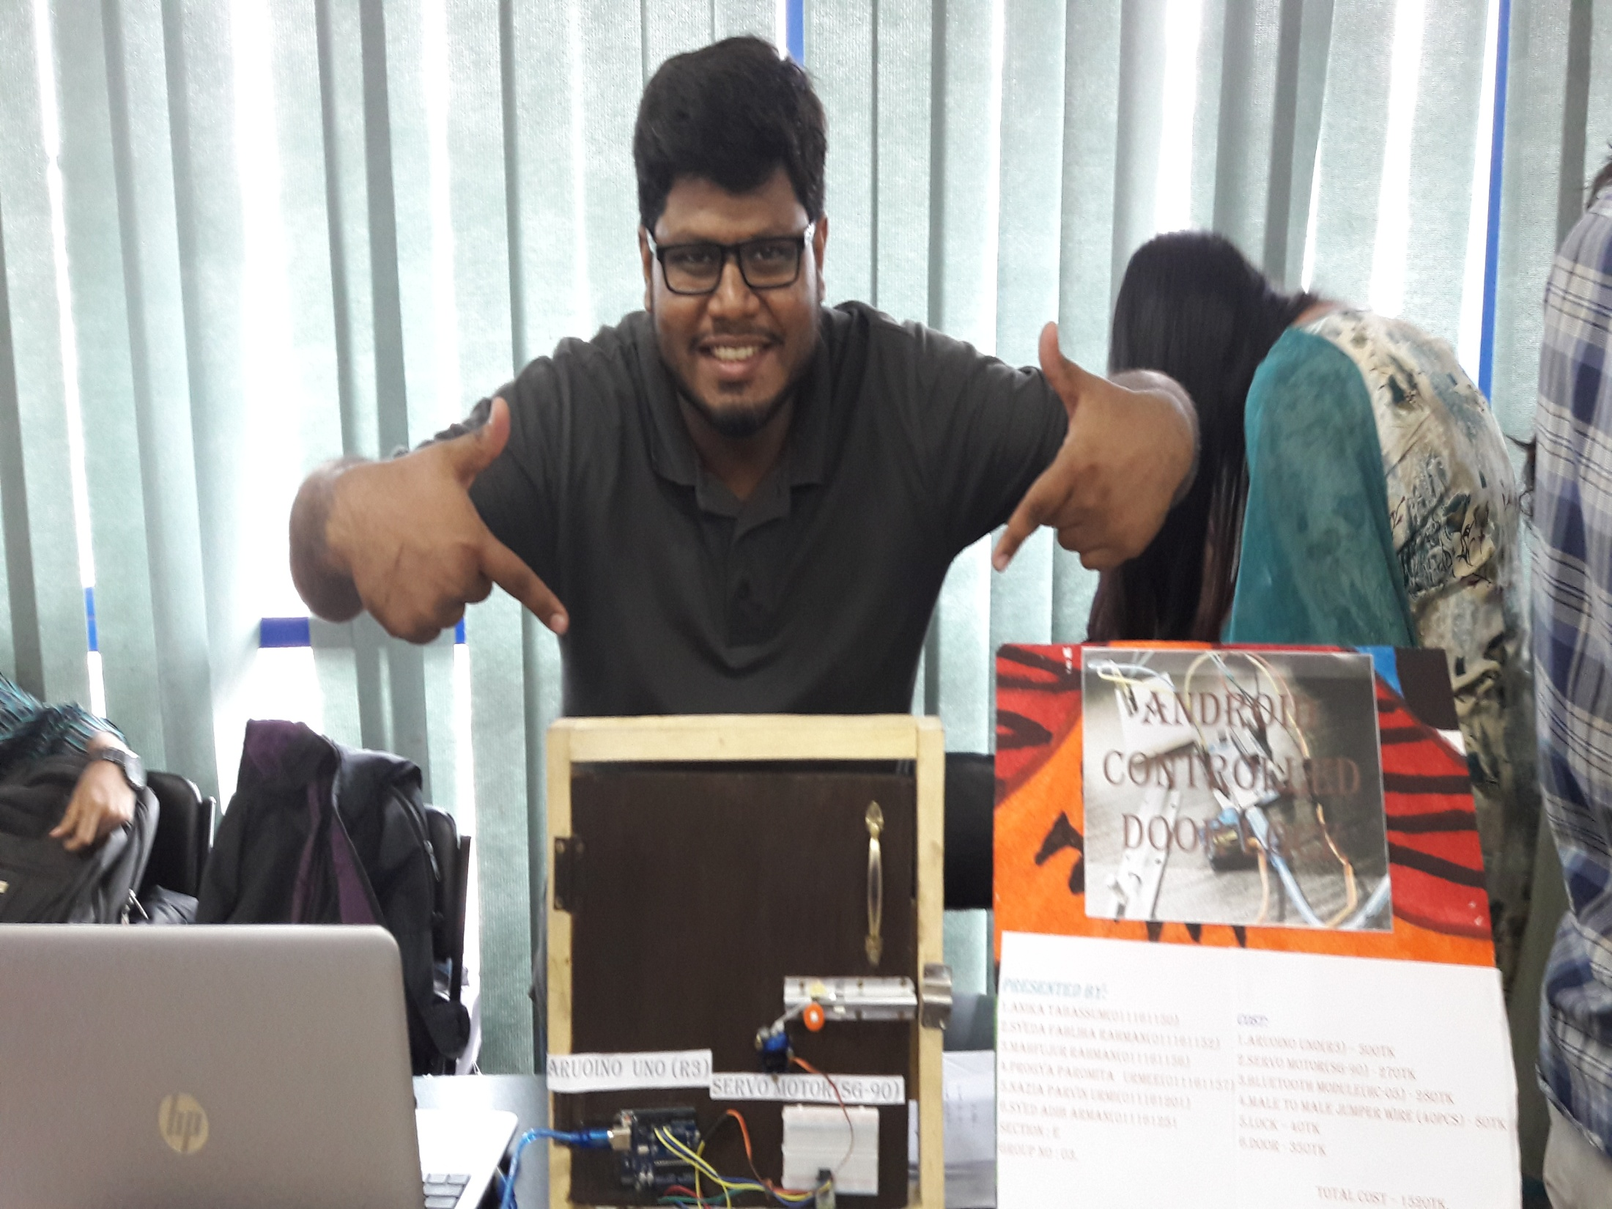
What is ANDROID CONTROLLED DOOR LOCK !
ANDROID CONTROLLED DOOR LOCK is a lock that is controlled by a smart phone .

Slide 5
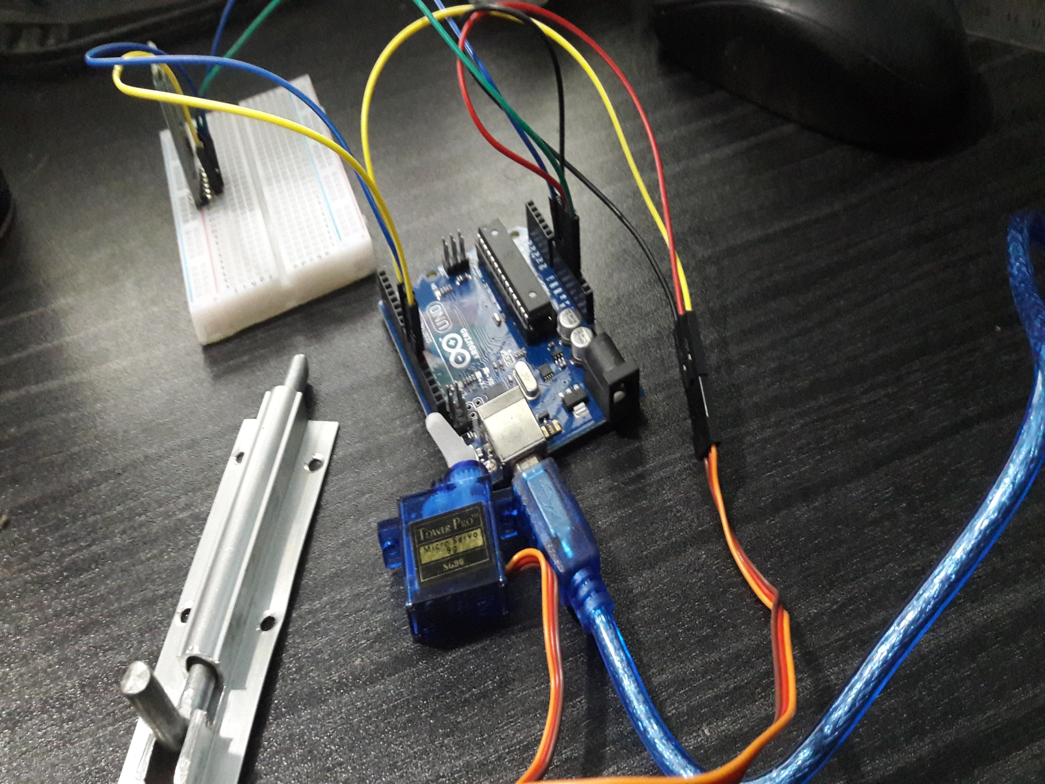
COMPONENTS
1.Arduino Uno(r3)
2.Servo MOTOR(SG-90)
3.Bluetooth MODULE(HC-05)
4.Male To Male Jumper Wire (40pcs)
5.Lock
6.Door
7. BREAD BOARD

Slide 6
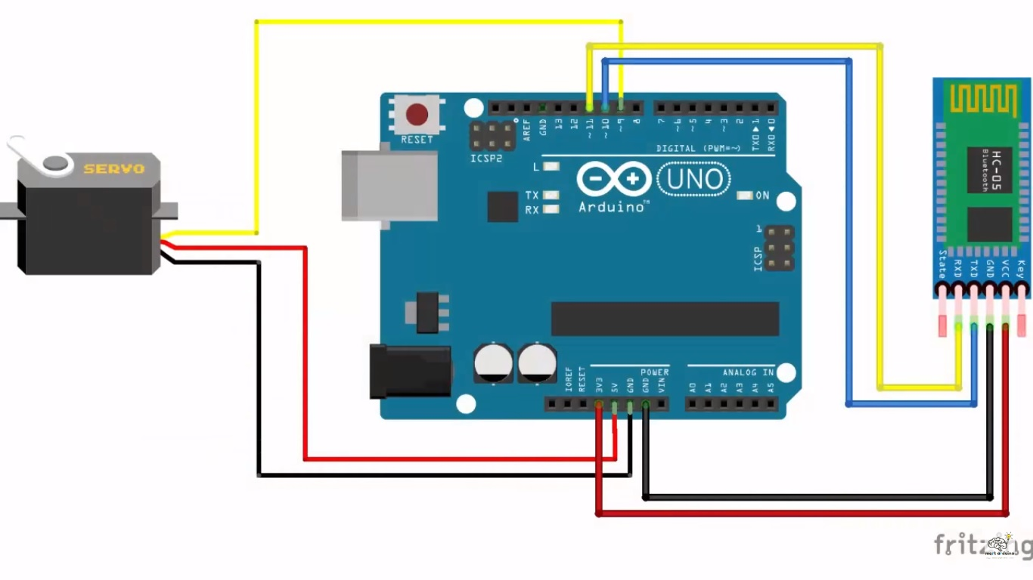
HOW DOES IT WORK….

Slide 7
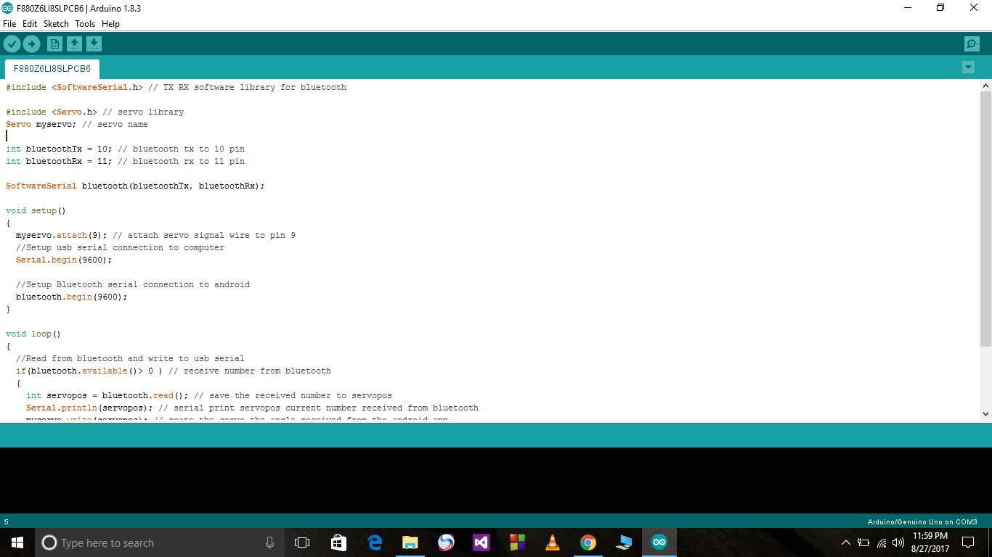
SOURCE CODE

Slide 8


A Short video…!

Slide 9
USEFULNESS
DIGITALIZATION
AUTOMATIC GARAGE GATE
PHYSICALLY DISABLE
AGED CITIZEN
OTHER

Slide 10
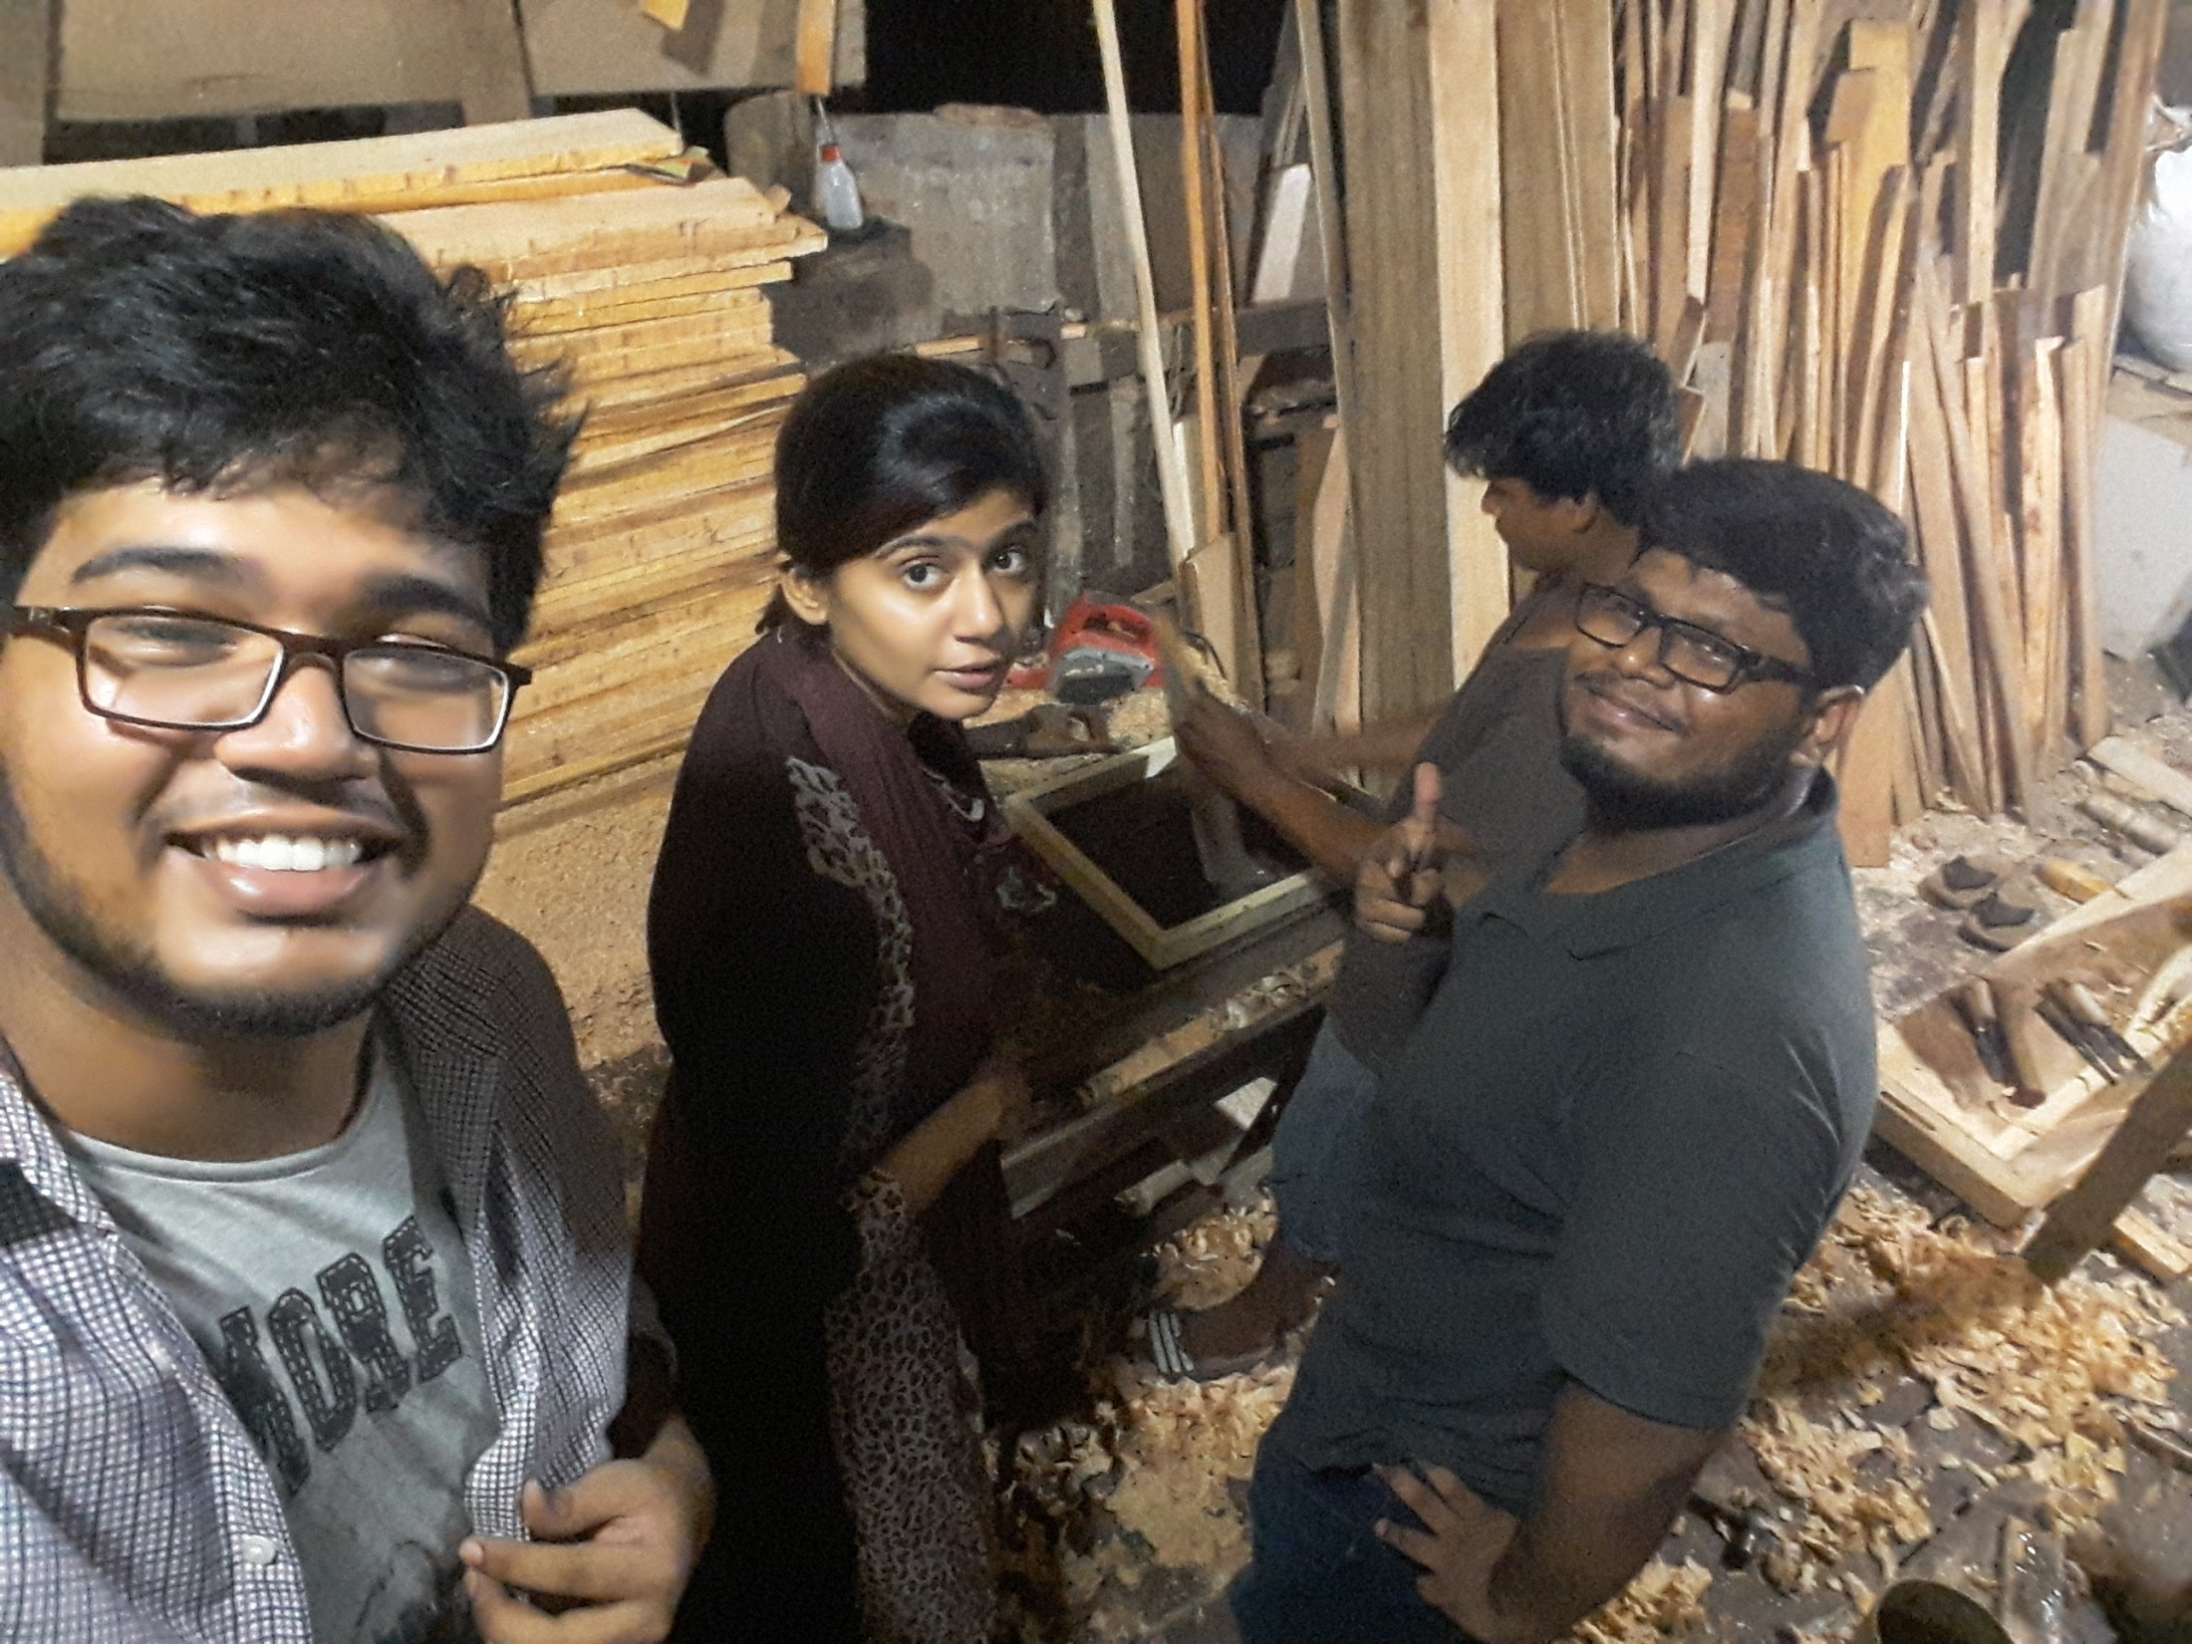
PROJECT COST
Cost:
1.Arduino-uno(r3) – 500tk
2.Servo Motor(sg-90) - 270tk
3.Bluetooth Module(hc-05) - 280tk
4.Male To Male Jumper Wire (40pcs) -80tk
5.Lock – 40tk
6.Door - 350tk
Total Cost – 1520tk.

Slide 11
MARKET VALUE
Why people should use our product
Reasonable price
Easy to use

Slide 12
LACKINGS
Security
Easily accessible

Slide 13
FUTURE IMPLEMENTATION
UPDATE OUR LOCK
ADD SECURITY SYSTEM
AUTOMATIC DOOR HANDLING.

Slide 14
Md. Mahfujur Rahman
Mail-mahfujbabu15@gmail.com
Contact- 01521212582

Slide 15

THANK YOU ALL.

